Slide 1
Stategic and Competitive Intelligence
DRONE SHOW ITALY
DREAM TEAM
28 May, 2025
Manh Truong Nguyen
Pietro Gagliardi
Luigi Ascione
Riccardo Ranieri

Slide 2
AGENDA OVERVIEW
01
INTRODUCTION TO THE MARKET
02
METHODS TO KEY INTELLIGENCE TOPICS
03
KEY INTELLIGENCE QUESTIONS

Slide 3
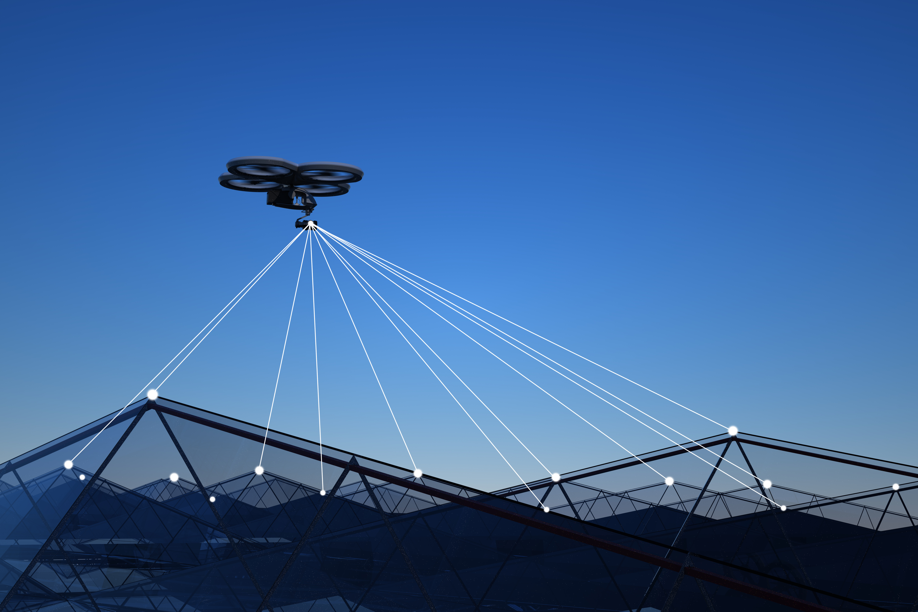

INTRODUCTION TO THE MARKET
Our research focuses on the product market, an innovative solution designed to make the product become a top-of-mind product. By understanding market demand, competition, and technology, we aim to unlock this new product's potential, addressing critical needs and driving innovation in the market. Through this research, we aim to provide insights into its successful development, launch, and adoption, creating lasting value for stakeholders.
Drone Show Industry

Slide 4
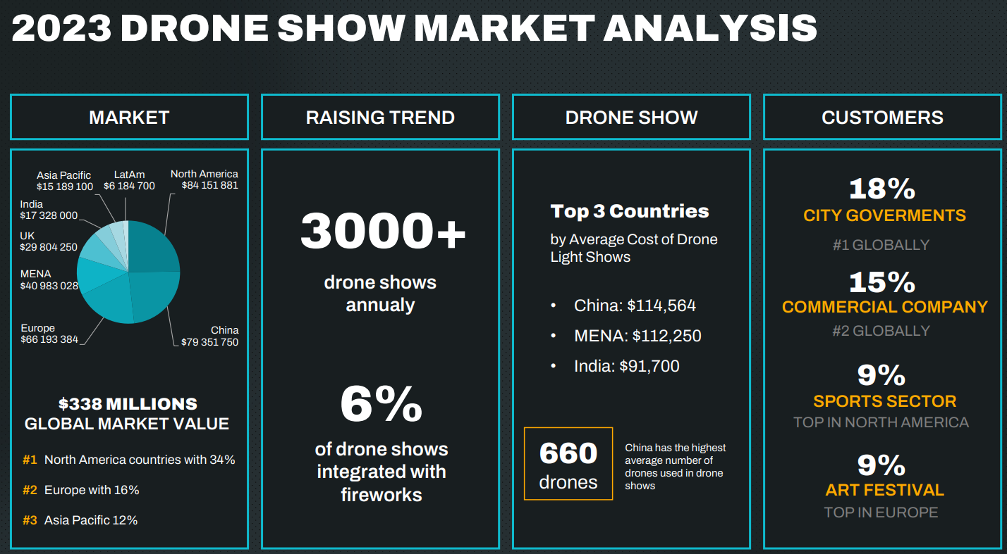

Slide 5


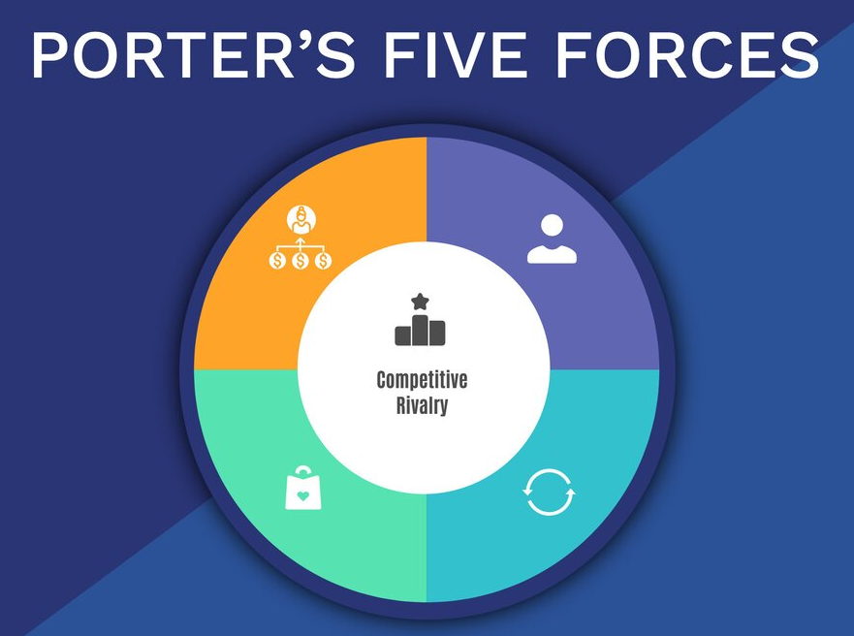

KEY INTELLIGENCE TOPICS AND QUESTIONS

Slide 6





ROADMAP TO KEY INTELLIGENCE QUESTIONS
1
3
PHASE
PHASE
Based on the Five Forces and VUCA analysis, we trained ChatGPT with this knowledge and asked it to generate 15–20 key intelligence topics relevant to our market.
We created a rule set based on key criteria - like clarity, feasibility, relevance, and impact - to guide ChatGPT in generating the top 20 most suitable questions.
Finally, we combined these results with insights from the introduction and analysis phase to select the top questions we believe can help our company’s growth in this market.
We asked ChatGPT to generate 8 - 10 questions for each topics
PHASE
PHASE
2
4

Slide 7





BARGAINING POWER OF BUYERS
MODERATE TO HIGH
Despite many potential buyers, most revenue comes from a few key clients, with orders from €20,000 to €500,000. Switching is possible but limited by customization, rules, and reputation
BARGAINING SUPPLIER POWER: REDUCED
Suppliers: Suppliers of drones, LED components, software platforms, skilled operators, and regulatory advisors.
The high number of drone operators and licensed suppliers in Italy and in the world strengthens companies' bargaining power in negotiating drone show services.
COMPETITIVE RIVALRY: MODERATE —
GROWING MARKET WITH STRONG INCUMBENTS AND TECHNICAL BARRIERS TO ENTRY.
THREAT OF NEW ENTRANTS:
MODERATE TO LOW
With startup costs between €45,000 and €500,000, along with technical and regulatory demands, market entry is capital-intensive and challenging for new competitors.
THREAT OF SUBSTITUTE: MODERATE
While cheaper alternatives like fireworks and projection mapping exist, they can't match the dynamic, aerial, and eco-friendly features of drone shows

Slide 8





SWOT
ANALYSIS
STRENGTHS
WEAKNESSES
Drone shows offer unique, innovative 3D entertainment experiences unmatched by traditional displays.
Environmentally friendly, aligning with EU green event initiatives.
Growing market demand from large public events and corporate clients.
High initial investment cost (~€500,000 for a large drone fleet).
Complex and strict regulatory environment limits expansion and operation.
Requires specialized skills and risk management; talent shortage exists.
S
W
OPPORTUNITIES
THREATS
Expansion into Eastern and Southern European markets as regulations mature.
Integration of emerging technologies such as AR and interactive mobile apps.
Partnership opportunities with event management (marketing) companies to offer bundled services.
New entrants benefiting from cheaper drones and open-source software.
Economic downturn
Supply chain vulnerabilities due to geopolitical factors.
O
T

Slide 9
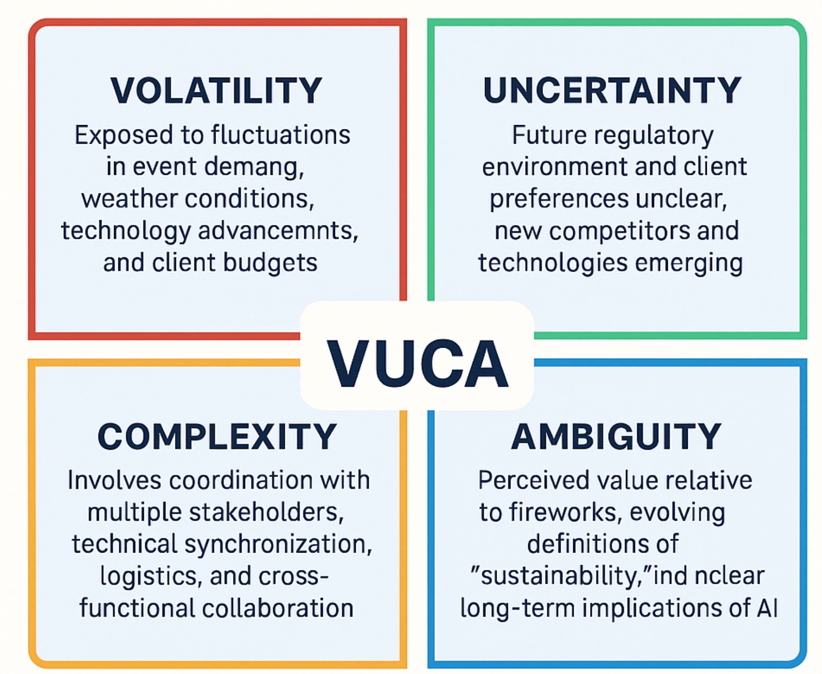
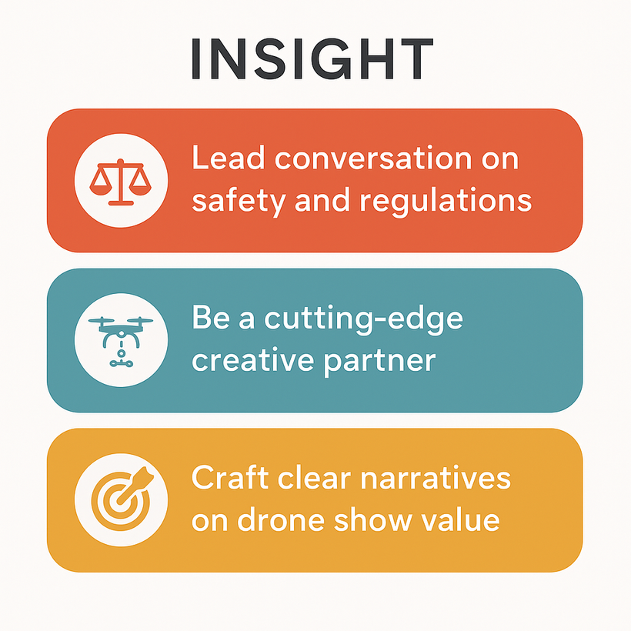




TOPICS FIELDS
Market and Industry
Competitive
Operational
Technology

Slide 10
ROADMAP TO KEY INTELLIGENCE QUESTIONS
1
3
PHASE
PHASE
Based on the Five Forces and VUCA analysis, we trained ChatGPT with this knowledge and asked it to generate 15–20 key intelligence topics relevant to our market.
We created a rule set based on key criteria - like clarity, feasibility, relevance, and impact - to guide ChatGPT in generating the top 20 most suitable questions.
Finally, we combined these results with insights from the introduction and analysis phase to select the top questions we believe can help our company’s growth in this market.
We asked ChatGPT to generate 8 - 10 questions for each topics
PHASE
PHASE
2
4

Slide 11
ROADMAP TO KEY INTELLIGENCE QUESTIONS
1
3
PHASE
PHASE
Based on the Five Forces and VUCA analysis, we trained ChatGPT with this knowledge and asked it to generate 15–20 key intelligence topics relevant to our market.
We created a rule set based on key criteria - like clarity, feasibility, relevance, and impact - to guide ChatGPT in generating the top 20 most suitable questions.
Finally, we combined these results with insights from the introduction and analysis phase to select the top questions we believe can help our company’s growth in this market.
We asked ChatGPT to generate 8 - 10 questions for each topics
PHASE
PHASE
2
4

Slide 12

ROADMAP TO KEY INTELLIGENCE QUESTIONS
1
3
PHASE
PHASE
Based on the Five Forces and VUCA analysis, we trained ChatGPT with this knowledge and asked it to generate 15–20 key intelligence topics relevant to our market.
We created a rule set based on key criteria - like clarity, feasibility, relevance, and impact - to guide ChatGPT in generating the top 20 most suitable questions.
Finally, we combined these results with insights from the introduction and analysis phase to select the top questions we believe can help our company’s growth in this market.
We asked ChatGPT to generate 8 - 10 questions for each topics
PHASE
PHASE
2
4

Slide 13
KEY INTELLIGENCE QUESTIONS
01
WHICH ENTERTAINMENT FORMATS ARE GAINING THE MOST CONSUMER ATTENTION?
02
WHO ARE THE MOST STRATEGICALLY IMPORTANT CLIENTS, AND WHAT ARE THE PROJECTED GROWTH TRENDS FOR THE MARKET?
03
WHAT TECHNOLOGIES TYPICALLY GO TOGETHER AND WHICH ONES CAN BE COMPETITIVE ADVANTAGES?
04
IS THERE A TECH PATTERN THAT SEPARATES ENTERTAINMENT-FOCUSED DRONE TOOLS FROM MULTIPURPOSE ONES?
05
IS THERE A TECH PATTERN THAT SEPARATES ENTERTAINMENT-FOCUSED DRONE TOOLS FROM MULTIPURPOSE ONES?

Slide 14
Drone Show Italy
THANK YOU
DREAM TEAM
28 May, 2024

